Slide 1
Cryptography and Cryptanalysis.
Week 4 | Lecture 1 (4.1.1)
While waiting for class to start:
Download and open the Jupyter Notebook (.ipynb) for Lecture 4.1.1
You may also use this lecture’s JupyterHub link instead (although opening it locally is encouraged).
Upcoming:
Reflection 4 released Friday @ 11 AM
Lab 4 released this Friday @ 12 PM
PRA (Lab) on Friday @ 2PM this week
Midterm - May 31 in lecture @ 9:10 AM

Slide 2
Cryptanalysis was a defining factor in WWII

Slide 3
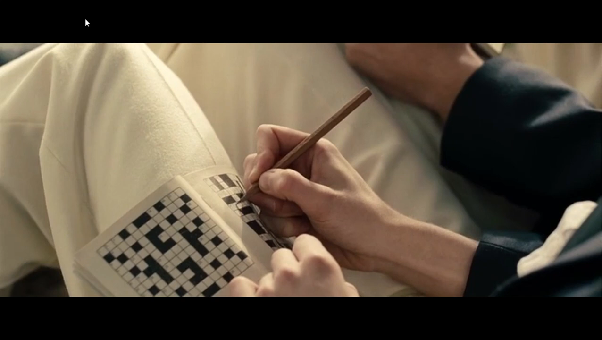

Slide 4
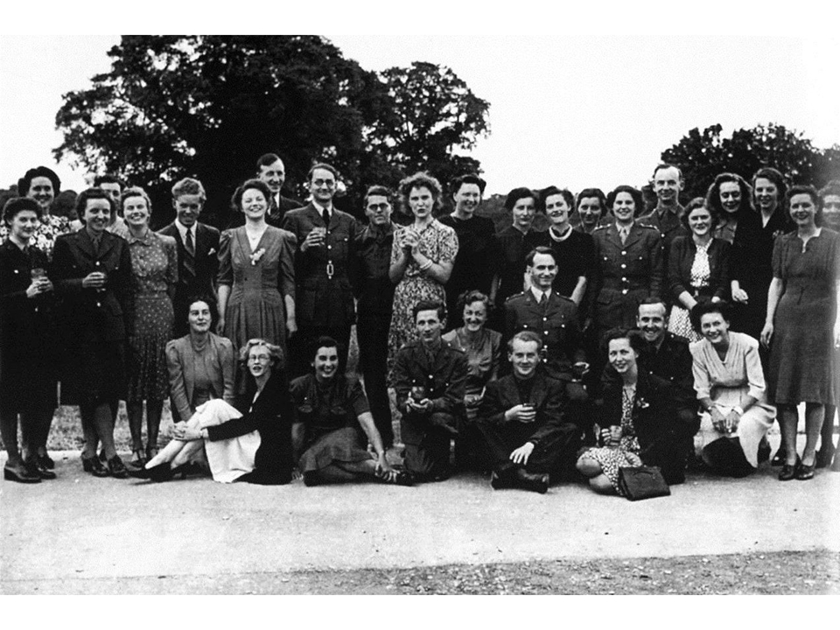
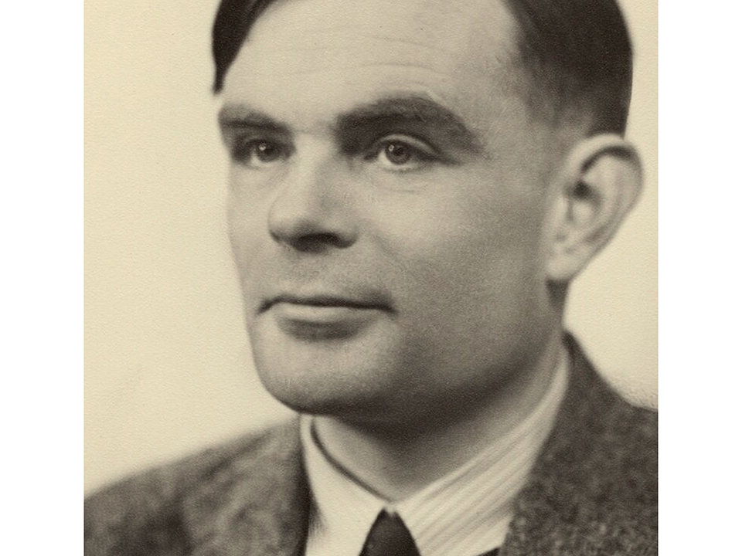
Intersection of history and technology
Alan Turing - The “Father” of Computer Science and Artificial Intelligence
Pioneered the technology to decrypt Nazi Germany's secret communications during World War II
Decryption machines were called “Turing machines”
Prosecuted for ‘gross indecency’ for being homosexual in 1952, died in 1954
Alan Turing circa 1951
Workers of Bletchley Park, centre of Allied Code-Breaking circa 1938
8,000 women, 75% of the workforce
Notes:
Bletchley Park was a converted private house which was taken over by the British Secret Intelligence Service (MI6 to you and me) in 1938. There was a small code-breaking organization between the wars called the Government Code & Cypher School, which was part of MI6, and they moved in just before the war began

Slide 5
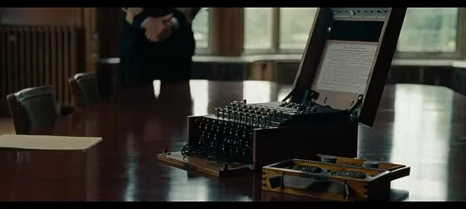

Slide 6

Intersection of history and technology
Turing Award
“Nobel Prize of Computing” recipients
2016 - Tim Berners-Lee, British computer scientist and inventor of the World Wide Web
2018 - Geoffrey Hinton, British-Canadian computer scientist and inventor of deep neural networks (at the University of Toronto!)
2022 - Robert Metcalfe, American Engineer and inventor of Ethernet
2023 - Avi Wigderson, Israeli computer scientist, contribute to research on randomness
Turing Test
The test of a machine’s ability to be indistinguishable from a human
5 supercomputers had passed as of 2023
Studies coming out now showing LLMs could be reaching 50% pass rate!
Modern uses of cryptography and ciphers
VPN (Virtual Private Networks) – encrypts your IP address and who you are!
https (the s stands for secure!) – encrypts your data being sent to other websites!
Cryptocurrency (you control your private cipher key!)
Email and messaging service encryption (iMessage, Outlook, etc.)
Notes:
Bletchley Park was a converted private house which was taken over by the British Secret Intelligence Service (MI6 to you and me) in 1938. There was a small code-breaking organization between the wars called the Government Code & Cypher School, which was part of MI6, and they moved in just before the war began

Slide 7
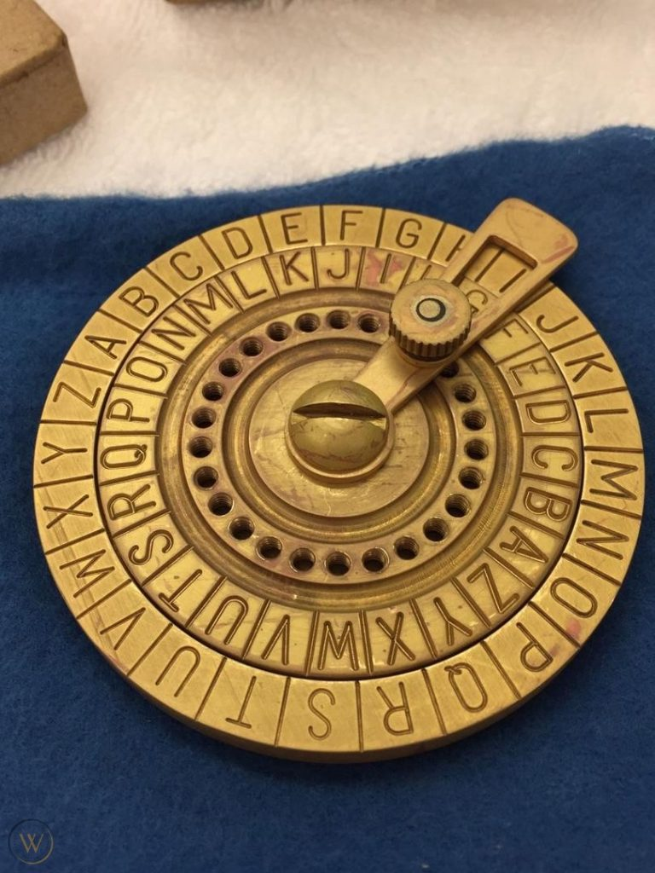
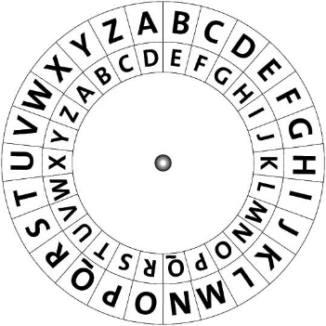
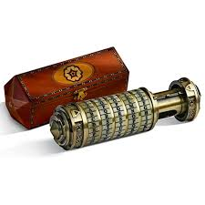
The Caesar Cipher was used in ancient Rome
Invented by Julius Caesar ~100 BCE
Also known as the Caesar Shift
Used in ancient Rome for secure military communications
Served as the foundation for the development of more sophisticated encryption methods

Slide 8
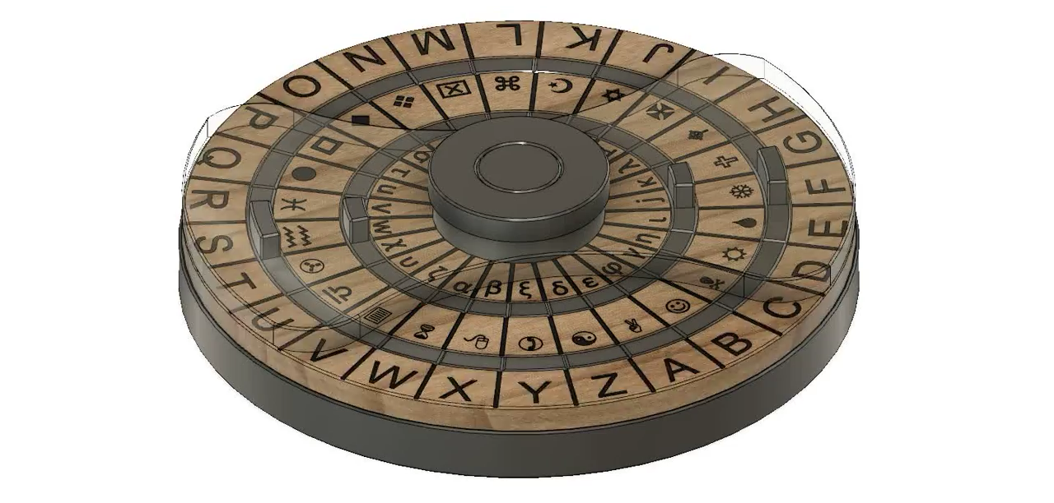
The cipher key matters!

Slide 9
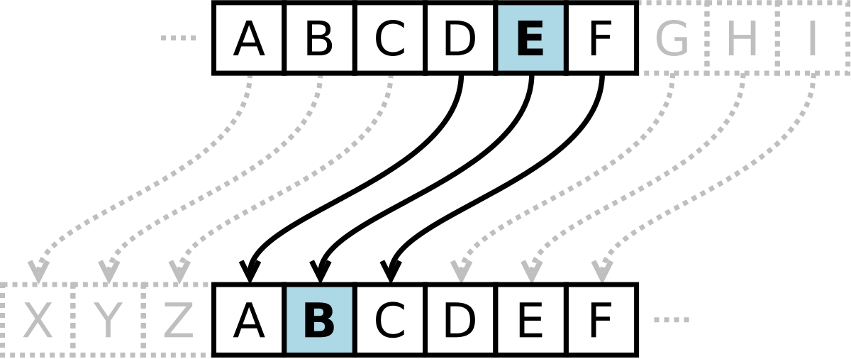
Also known as the Caesar Shift
Goal: Write a Python program that enables us to encrypt a message that can only be read by someone with the secret key.
The key will represent how much we shift each letter.
Also known as a Caesar Shift

Slide 10
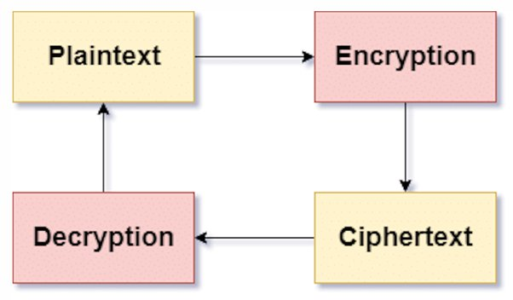
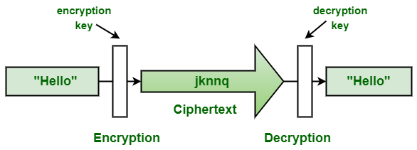
Cryptography and Cryptanalysis work against one another
To create our own cryptography code, we can take advantage of:
user input,
loops,
conditional statements,
ASCII codes,
string methods,
comparison operators
Cryptography
Cryptanalysis

Slide 11

Some friendly reminders…

Slide 12

RECAP: Making Choices
statements
Sequential structure
statements
Conditional structure
if
True
condition
statements
statements
statements
False
statements

Slide 13


Adding the elif (else if) statement
The most general form of the if conditional statement is:
if condition1:
body1
elif condition2:
body2
elif conditionN:
bodyN
else:
other_body
Note the colons (:) and the indents!
ONLY 1 body will be executed.
if statement is True, execute body1, exits if structure
if statement is False, continue to elif statement
elif statement is True, execute elif body, exits if structure
elif statement is False, continue to next elif statement
All if’s and elif’s are False, execute else statement

Slide 14
Making Choices
statements
True
if
condition
Conditional structure
False
statements
elif
True
condition
statements
False
else
statements

Slide 15
Function Definitions
def function_body(parameters):
1. “““DOCSTRING””” (optional)
2. Code the does the thing
3. return [expression]
The return statement is options and if it is not included, it’s the same as writing return None

Slide 16
Input
Python has a built-in function named input for reading text from the user.
The general form of a input function call:
The argument is the text you want displayed to the user.
“What is your name?”
The value returned by the input function is always a string.
input(argument)

Slide 17
String Comparisons
Boolean comparisons can also be applied to strings, whether single characters or sets of characters
Compare two strings by their dictionary order, comparing letter by letter
Description | Operator | Example | Result of example
equality | == | 'cat' == 'cat' | True
inequality | != | 'cat' != 'Cat' | True
less than | < | 'A' < 'a' | True
greater than | > | 'a' > 'A' | True
less than or equal | <= | 'a' <= 'a' | True
greater than or equal | >= | 'a' >= 'A' | True

Slide 18
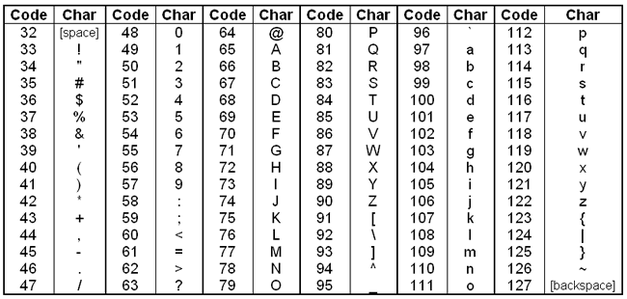
Strings as Integers (ASCII Encoding)
Each character in a string is actually represented by integers following the ASCII encoding
American Standard Code for Information Interchange
All uppercase letters come before all lowercase letters
Uppercase “Z” is less than lowercase “a”

Slide 19

Strings as Integers (ASCII Encoding)
When you compare two strings, what you are really doing is comparing their numerical representations
For example in ASCII the characters ‘a’ and ‘w’ are encoded as 97 and 119, respectively
The comparison ‘a’ > ‘w’ would translate to 97 > 119, evaluating to False
0-9
48-57
A-Z
65-90
a-z
97-122

Slide 20
ASCII Encoding
To obtain the ASCII (integer) representation, we use the built-in function ord
To convert from ASCII integer representation back to a string, we use the built-in function chr
Think ”character” (i.e. what is this integer’s character)
>>> ord(‘a’)
97
>>> chr(97)
‘a’

Slide 21
Cryptography and Cryptanalysis.
Week 4 | Lecture 1 (4.1.1)
While waiting for class to start:
Download and open the Jupyter Notebook (.ipynb) for Lecture 4.1.1
You may also use this lecture’s JupyterHub link instead (although opening it locally is encouraged).
Upcoming:
Reflection 4 released Friday @ 11 AM
Lab 4 released this Friday @ 12 PM
PRA (Lab) on Friday @ 2PM this week
Midterm - May 31 in lecture @ 9:10 AM

